Slide 1
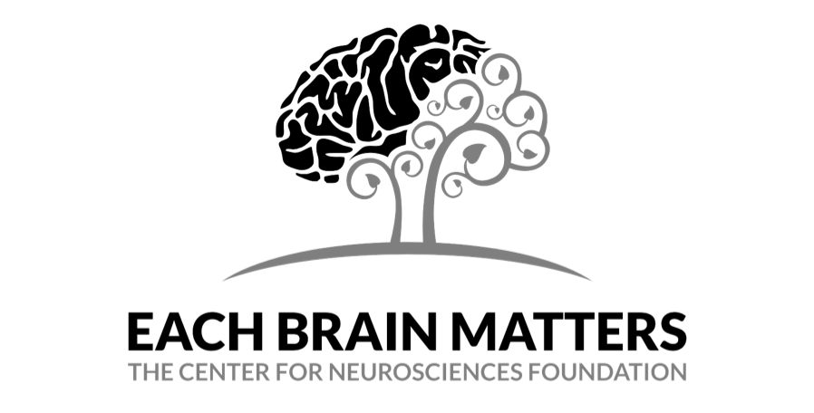
Optical Illusions
Your brain won’t believe your eyes!

Slide 2
What is an optical illusion?
An optical illusion simply put is something that tricks our vision. The interesting part is how this works. As our eyes send information to our brains we do not just see it - but rather process it to create a perception of the world. Living in a 3D world, our brains take in clues about lighting, shading, depth and positioning to help us interpret things.
Due to this our brains are easily fooled when looking at 2D images, but it can also show some of the impressive things our visual system can do.

Slide 3
See for yourself...

Slide 4
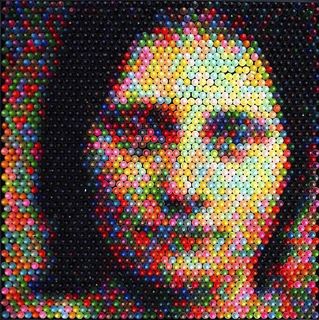
The placement of the crayons in this picture create a rough outline of a women’s head and the brain completes the rest of the image.
This is due to the principle of proximity, our brain’s desire to turn vague images into familiar images using context and pattern.

Slide 5
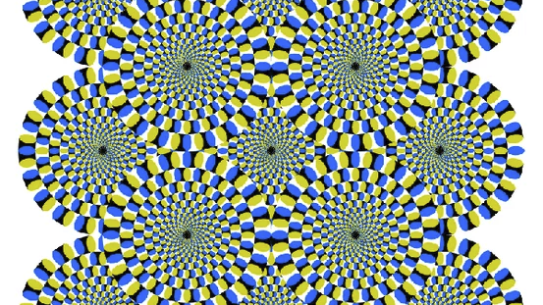
Are those circles moving?

Slide 6
No they aren’t.
Scientists believe images similar to this appear to be moving due to fixation jitters: involuntary eye movements that give the illusion that objects near what you are fixated on are moving. They also think this may cause the motions detectors in the visual cortex to get confused and believe they’re seeing movements.

Slide 7
Herman Grid Illusion
When you focus on any specific dot, it is clearly white. But when your attention shifts away as you look at the grid, the dots seem to shift between white and gray.
The effect is commonly explained by a neural process called lateral inhibition. The setup of the white bands creates a situation where there is more light surrounding the intersections than there is along the bands between intersections. Thus the region of the intersection is
more inhibited, and darker spots appear.

Slide 8
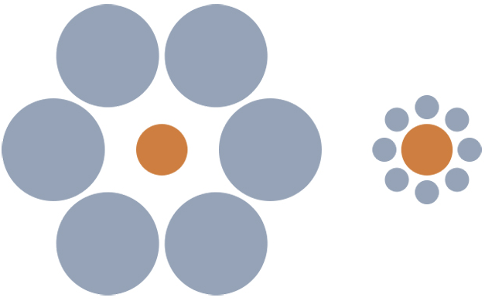
Ebbinhaus Illusion
Believe it or not, the two orange circles are exactly the same size! Both the size of the blue circles and the distance between them and the orange circles contribute to making the left appear larger than the right.

Slide 9
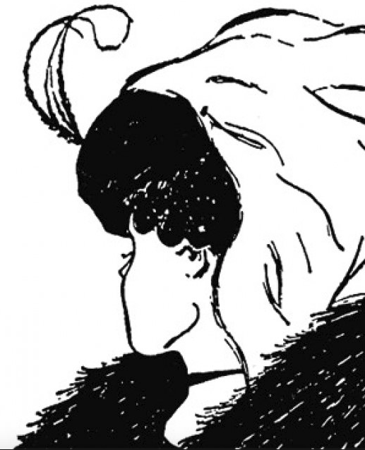
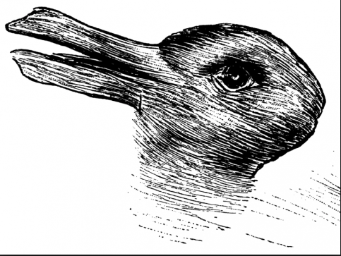
Old lady or a young woman?
Duck or rabbit?
Ambiguous images tend to look like more than one thing depending on how it is viewed. Studies suggest that the way we see these images can be influenced by our memories. Things like age, experiences, and education can all change the way you think and see things.

Slide 10
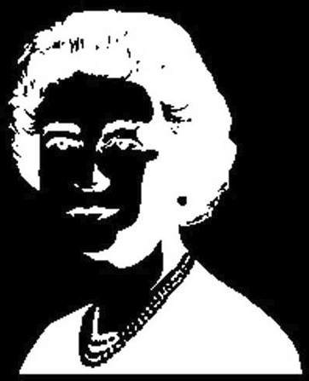
Stare at the nose of the woman for 60 seconds. Then close your eyes.
Did you see the positive of the image?
This is called a two-fold illusion and is caused by neural adaptation. The receptors in your eyes become taxed from staring at an image for too long. When you close your eyes, the receptors that were not used to view the negative image take over, allowing you to see the positive!

Slide 11
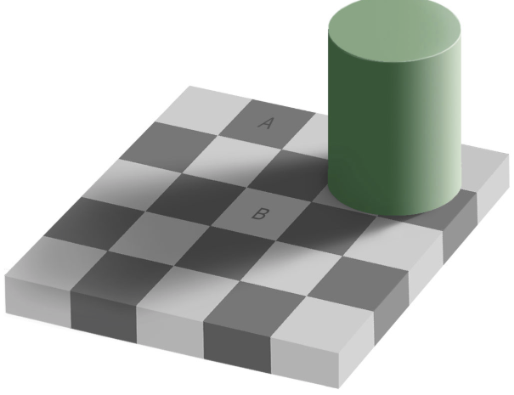
Squares A and B are remarkably the same color! Your brain is interpreting them as different colors based on the surrounding colors and shadows. We expect the cylinder to cast a shadow and because we are used to compensating for shadows in real life, we perceive it as A being darker than B.

Slide 12
After staring at this for a while, the image will begin to fade away. This is because our visual system adapts to sensory stimuli and will stop responding if the stimuli is unchanging, causing the image to disappear from consciousness

Slide 13
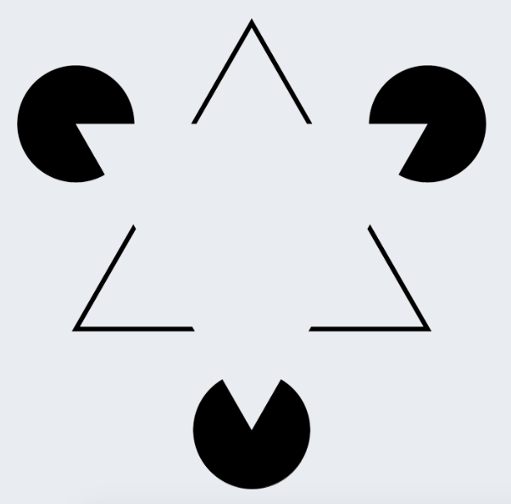
Our brains tend to seek closure with our visual perception. We are trained to fill in gaps and finish shapes and lines. Therefore we sometimes perceive blank space as objects even when they aren’t.

Slide 14
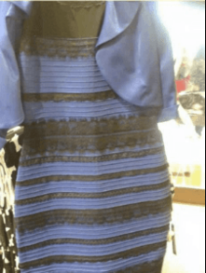
The dress that rocked the internet
If you have any social media accounts, you have probably seen this dress before and likely even argued about which color it is; black and blue or white and gold?
What the social media world didn’t realize, is that this is a color illusion.

Slide 15
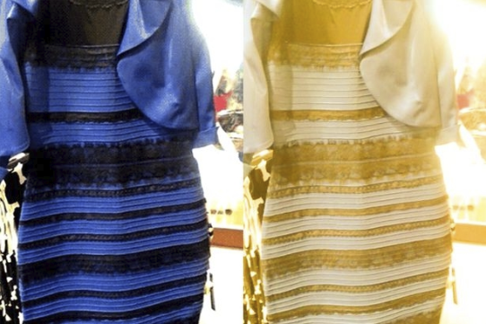
The dress that rocked the internet
The differences in color perception are likely due to assumptions the brain makes about the illumination of the garment so that it will appear the same under different lighting, a property known as color constancy. Those who saw the dress as white and gold may have assumed it was lit by daylight, and therefore our brains ignored the shorter blue waves. While those that saw it as blue and black may have assumed it was lit by artificial night lighting, so our brains ignored warmer red waves.

Slide 16
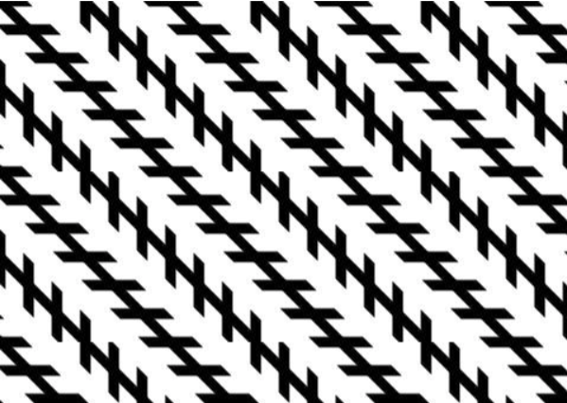
Zollner Illusion
The oblique lines look as if they are crooked and will diverge, although they are all parallel.
This effect can be attributed to the way the brain processes angles. This theory suggests that the brain exaggerates acute angles and underestimates obtuse angles. The brain then adjusts the angles on the transverse lines to create the illusion that the longer lines are slanted.
Alternatively, the illusion may be caused by an impression of depth. The fact that shorter lines are on an angle to the longer lines may help to create the impression that one end of the longer lines is nearer to the viewer than the other end.

